Slide 1
Law of Cosines SAS
Chapter 13.6
By Chase Midkiff and Josh Escher

Slide 2
Why use Law of Cosines?
Use it to solve sides or angles of a triangle that isn’t a right triangle.

Slide 3
Word Formula
Side squared equals the sum of the squares of the other two sides minus two times the product of the two sides times the cosine of the included angle.

Slide 4

Mathematic Formula
a² = b²+c²-2(bc)*Cos A
$b^{2}$ = a²+c²-2(ac)*Cos B
$c^{2}$ = a²+b²-2(ab)*Cos C

Slide 5
Step-by-step Problem
Solve ABC with a=22, b=15, and C=108°
Step 1: Insert your given numbers into your equation.
c²=15²+22²-2(15)(22)*cos 108°
Step 2: Put that equation in your calculator.
Note: You should end up with $c^{2}=912.95$
Step 3: Then you should square root that number.
Note: Your final answer then should be c=30.2
Step 4: Use the Law of Sines to find the rest of your triangle.

Slide 6
Step-by step (continued)
Step 5: You should then set up this: $\frac{\sin{108°}}{30.2}$=$\frac{\sin{x}}{15}$
Note: this will give you angle B which should be roughly 28.2°.
Step 6: Do the same to find angle A.
$\frac{\sin{108°}}{30.2}$=$\frac{\sin{x}}{22}$ This equation should equal roughly 43.9°.

Slide 7
Final Triangle of the Step-by-step
B
28.2°
30.2
22
43.9°
108°
A
C
15

Slide 8
Independent problem
Solve triangle ABC if a=19, C=85°, and b=26.

Slide 9
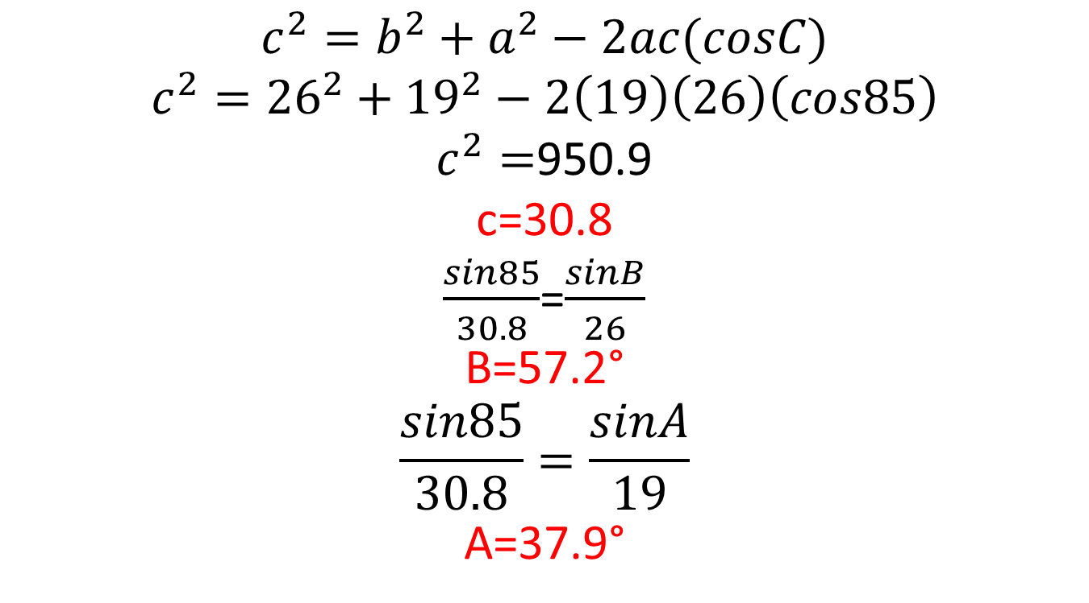
Answer
$$c^{2}=b^{2}+a^{2}−2ac(cosC)$$
$$c^{2}={26}^{2}+{19}^{2}−2\left(19\right)\left(26\right)\left(cos85\right)$$
$c^{2}=$950.9
c=30.8
$\frac{sin85}{30.8}$=$\frac{sinB}{26}$
B=57.2°
$$\frac{sin85}{30.8}=\frac{sinA}{19}$$
A=37.9°
Use law of sines to find the other angles!!

Slide 10
Finished triangle
B
57.2°
30.8
19
37.9°
85°
A
C
26

Slide 11
Word problem
The lengths of the diagonals of a parallelogram are 8 ft. and 12 ft. Find the lengths of the short sides of a parallelogram if the diagonals intersect at an angle of 24°.

Slide 12
Answer
6 Feet
4 Feet
24°
4 Feet
6 Feet
6 Feet
C
4 Feet

Slide 13

Answer
$c^{2}=6^{2}+4^{2}−2\left(6\right)\left(4\right)\left(cos24\right)$
$c^{2}=52−48$(cos24)
$c^{2}=52−43.9$
$c^{2}=8.1$
$c=2.8$

Slide 14
The End
Chase Midkiff and Josh Escher

