Slide 1
Quarter 4 for Dummies
Wesley Burkert and Brittany Unger

Slide 2
Law of Sines
Used on triangles that don’t contain right angles
You need to know AAS ASA
AAS
ASA
10
50
60
36
73
14

Slide 3
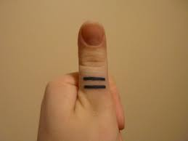
Law of Sines
Definition- The ratio of a side to the sine of its angle is equal to the ratio of any other side to the sine of its angle.
SinA
SinB
SinC
a
b
c
$$\frac{a}{sinA}$$
$$\frac{b}{sinB}$$
$$\frac{c}{sinC}$$
B
c
a
A
C
b

Slide 4
Example #1
Solve ABC with A=94 C=57 and b=25
AAS
94
57
25

Slide 5
Example #1, Step One
19
94 + 57= 161
180 – 161= 19
B=19

Slide 6
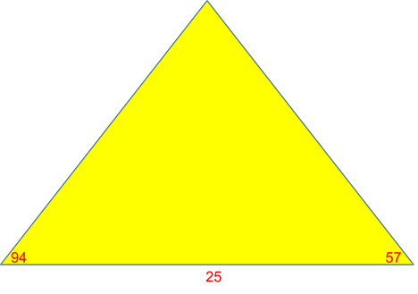
Example #1, Step 2
70.7
$$\frac{b}{sinB}=\frac{c}{sinC}$$
$$\frac{25}{sin19}=\frac{c}{sin67}$$
Cross Multiply
$$25sin67=csin19$$
c=70.7

Slide 7
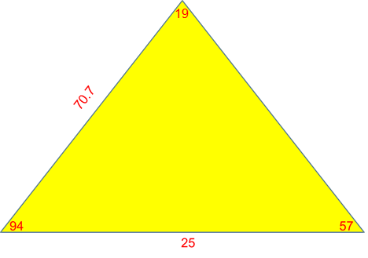
Example #1, Step 3
76.6
$$\frac{25}{sin19}=\frac{a}{sin94}$$
25sin94=a*sin19
a=76.6

Slide 8
Finished Product!!!
76.6

Slide 9
Example 2
Find ABC if B=85, C=47, a=19
85
19
47

Slide 10
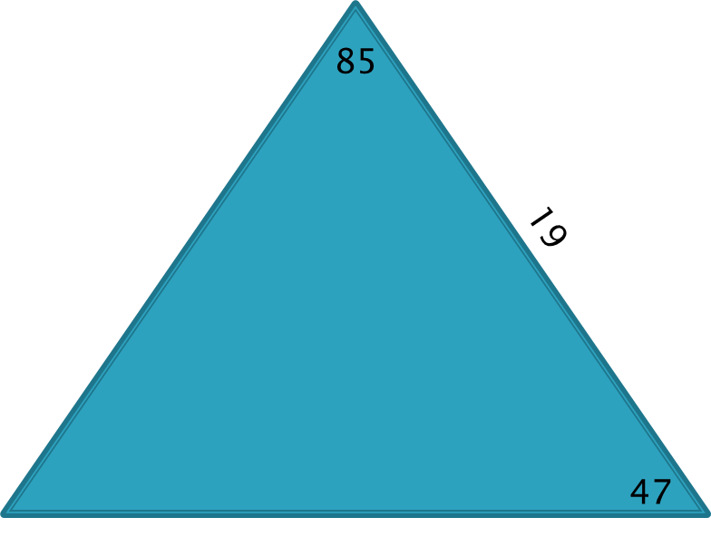
Example 2, step 1
$$85+47=132$$
48
$$180−132=48$$
$$A=48$$

Slide 11
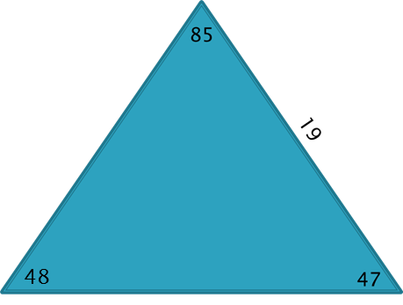
Example 2, step two
18.7
$$\frac{Sin48}{19}=\frac{Sin47}{c}$$
19sin47=c*sin48
c= 18.7

Slide 12
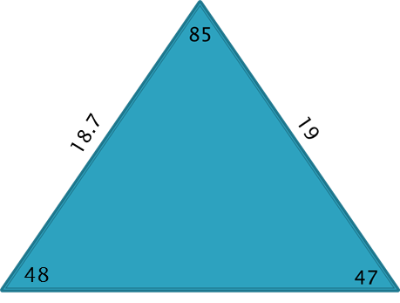
Example 2, step 3
$$\frac{sin48}{19}=\frac{sin85}{b}$$
25.5
$$19sin85=b∗sin48$$
25.5

Slide 13
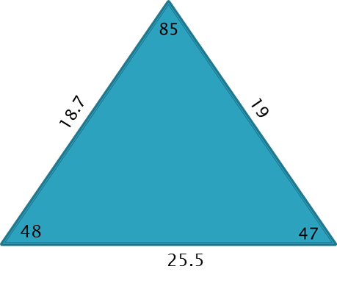
Finished Product!!!!!!!

Slide 14
Do it yourself
Solve ABC with C=107, B=25, b=15

Slide 15
Answer
25
33.9
26.4
107+25= 132
180-132= 48
48
107
A= 48
15
$$\frac{sin25}{15}=\frac{sin48}{a}$$
15sin48=a*sin 25
a= 26.4
$$\frac{sin48}{26.4}=\frac{sin107}{c}$$
26.4sin107=c*sin48
c=33.9

